Slide 1
Your Time
Sean Taylor
Principles of UX
Final Project

Slide 2
Table of Contents
Use Case
User Personas
Storyboard
Wireframe
Prototype
Final Design
Obstacles and Victories

Slide 3
Use Case
The product that I will be designing will be a payroll system.
With a payroll system there are many different types of users; the worker, the boss and the HR representative. Each user will perform different actions with the system. A user will use it to enter their daily time, check on used hours for their PTO and sick leave, and request future time off. The boss will be able to perform the same actions as the user as well as approving all of their team's timesheets. The HR representative will be able to view the workers time sheets, add and remove time code, and has direct interaction with the actual paying of the employee either via an in house or 3rd party vendor.
With this design I would create it around the functionality that each user needs with the system. By creating personas for each user I will better be able to understand the process each type of user would take when using a payroll system. Thus allowing me to tailor the system as best as possible to their needs. When appropriate I would bring in real users to gather insights on their needs, have them test out the prototypes and to make sure that the system is working as efficiently for them as possible. By creating WAADs, HTI's, task sequence models, etc. it will allow me to plan out the flow of the user as best as possible.

Slide 4
User Personas- Primary
Standard User – Joe Code
I chose this user because one of the main purpose of a payroll system is so that your workers can input their hours and get paid. They will be the most common but the most important type of user for this system. Joe Code will be my primary user for this project.
Joe Code is an entry level worker at the company. Joe is paid on an hourly base, not project depending. Meaning that for each project he works on he will be paid the same amount. Every Friday Joe fills out his timesheet. In a typical week he will work between the hours of 9am-6pm, with a one hour lunch break from Noon-1pm every day. He's assigned to two different projects right now, and each project requires Joe to fill out how many hours he worked on that project each day.

Slide 5
User Personas – Secondary
Manager User - Sam Boss
Whenever we are talking about money this is always an area that is checked and double checked. No company would just let their workers input their hours without having someone checking them. That is the role of the manager. It is their job to check that their team has inputted their hours accurately which is why I chose to include this role in my project.
Sam Boss will be able to perform all the same actions as Joe Code but also the added Manager privileges. Each week Sam needs to go in and approve all of the timesheets for her Team. For each team member she is able to see how many hours they reported and to what timecodes (projects) they are charging. Sam can either accept or deny the time sheet. Each team member is able to see on their time sheet if it was approved or denied by their boss.
Admin User - Sally from HR
I chose to include an admin user in this project because it adds for another layer of depth. Although this role could be taken on by the Manager User, in a large enough company this is often separated.
Sally is the office's HR Representative. It is her job to make sure that when new projects come about that their time codes, for workers to charge to, are inputted into the system. Sally is able to pull reporting data when need be. She is able to see reports on how much money they are spending on a specific project, who is charging to a project and how many hours are being spent for each project.

Slide 6
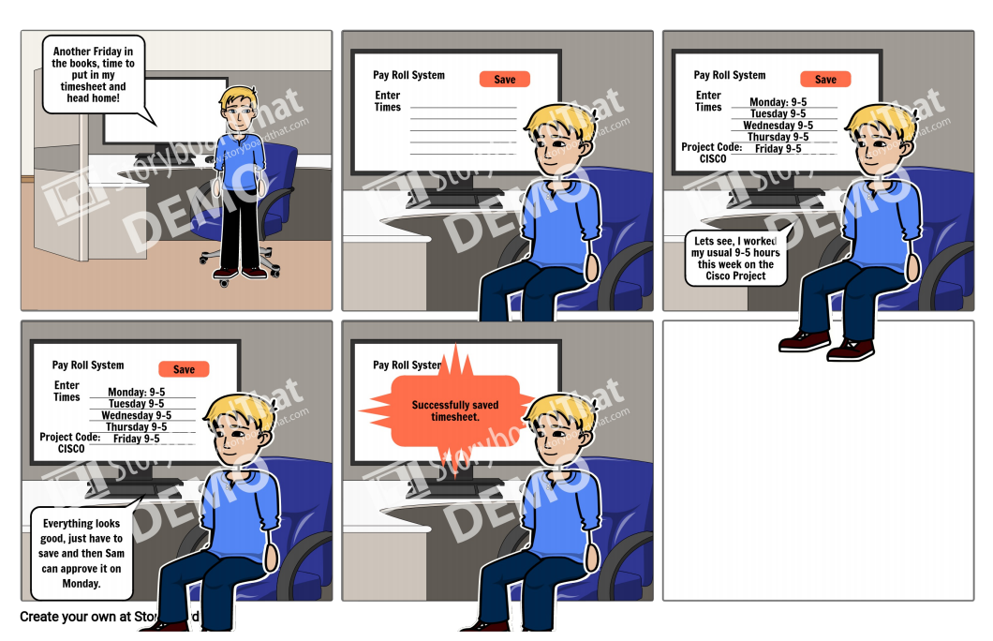
Storyboard – John Code

Slide 7
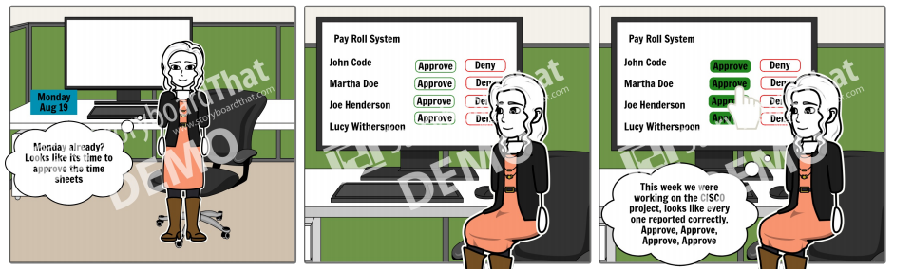
Story Board – Sam Boss

Slide 8
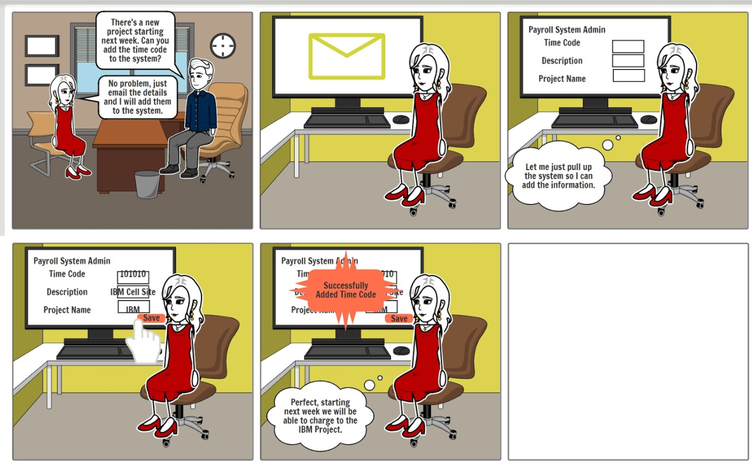
Story Board – Sally from HR

Slide 9
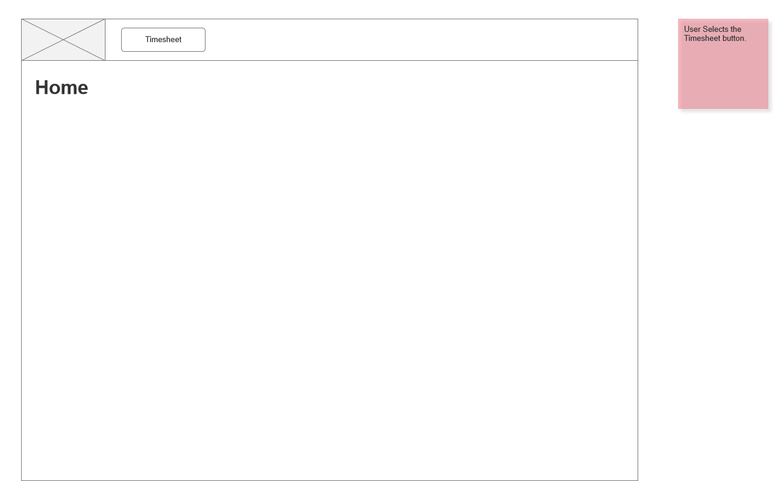
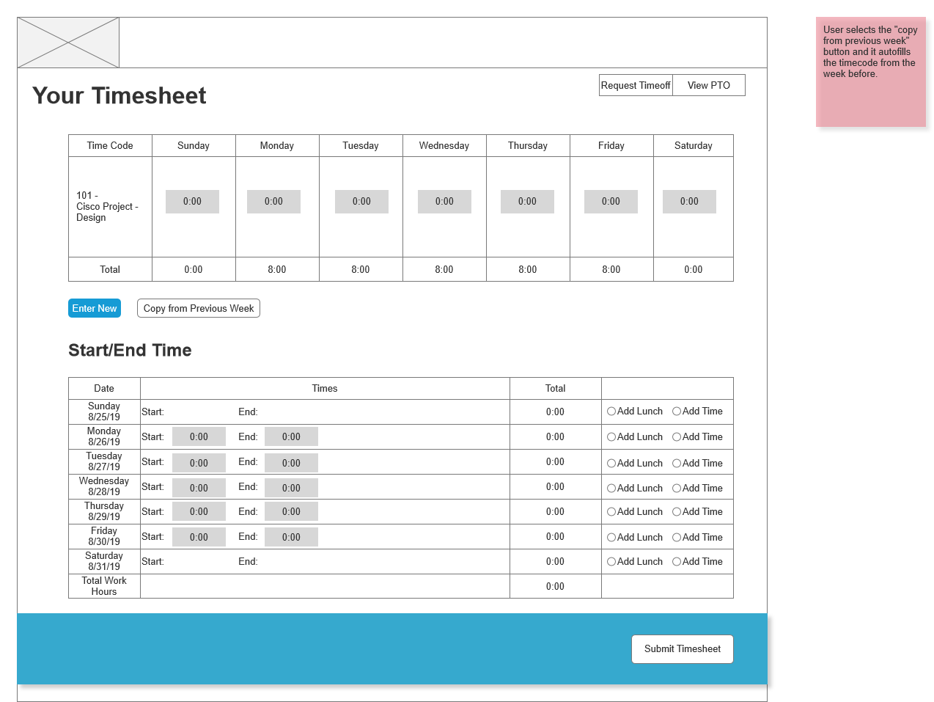

Wire Frame
Fill out hours worked
Select Timesheet button
Select Copy from Previous week button

Slide 10
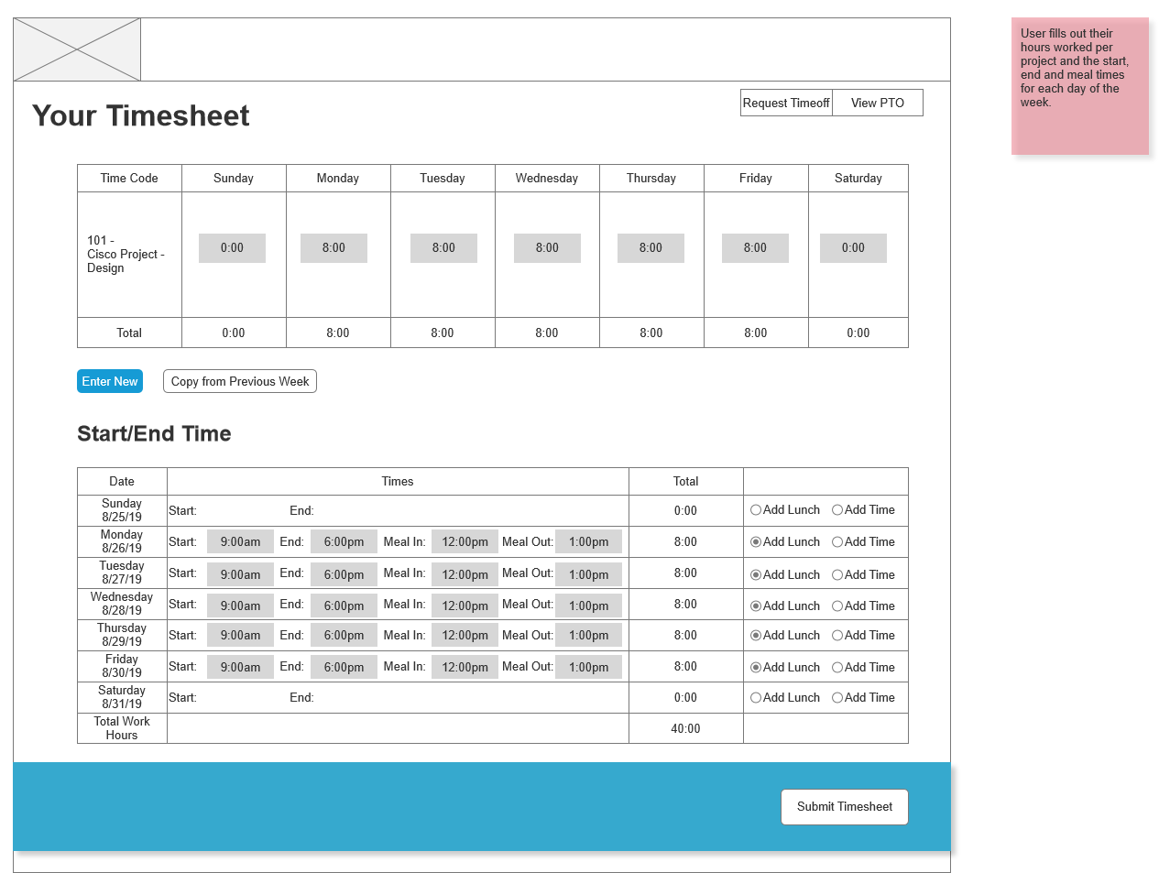
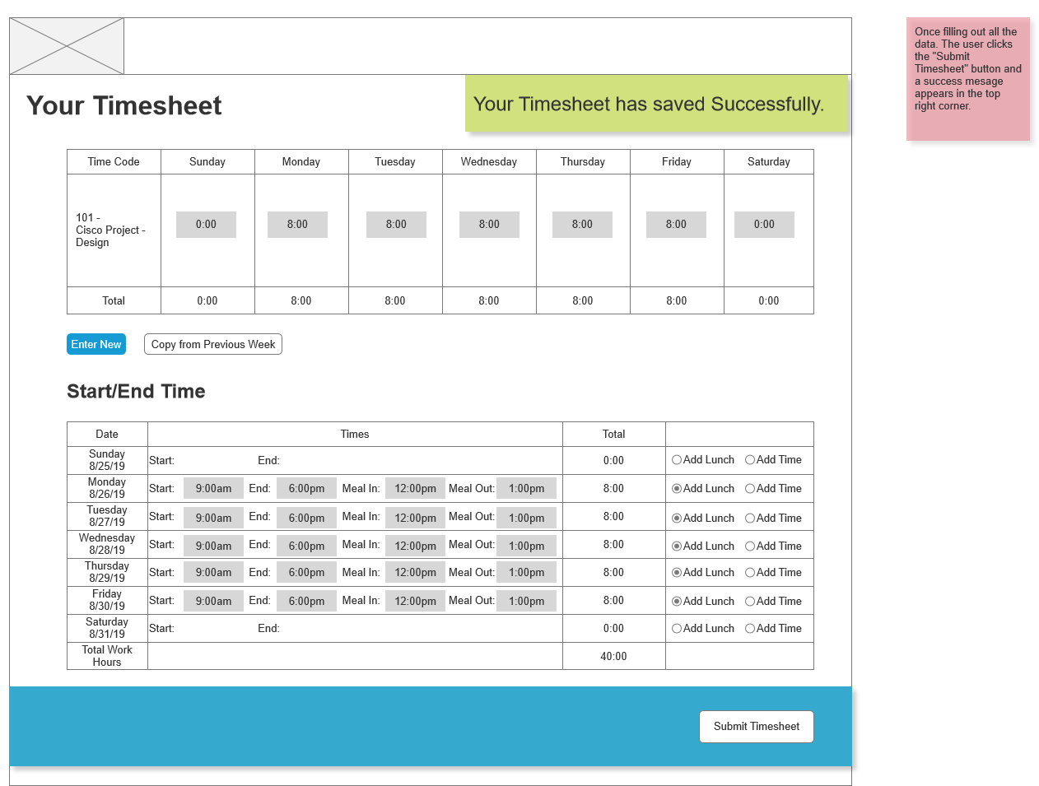
Wire Frame
Click
Submit
Timesheet

Slide 11
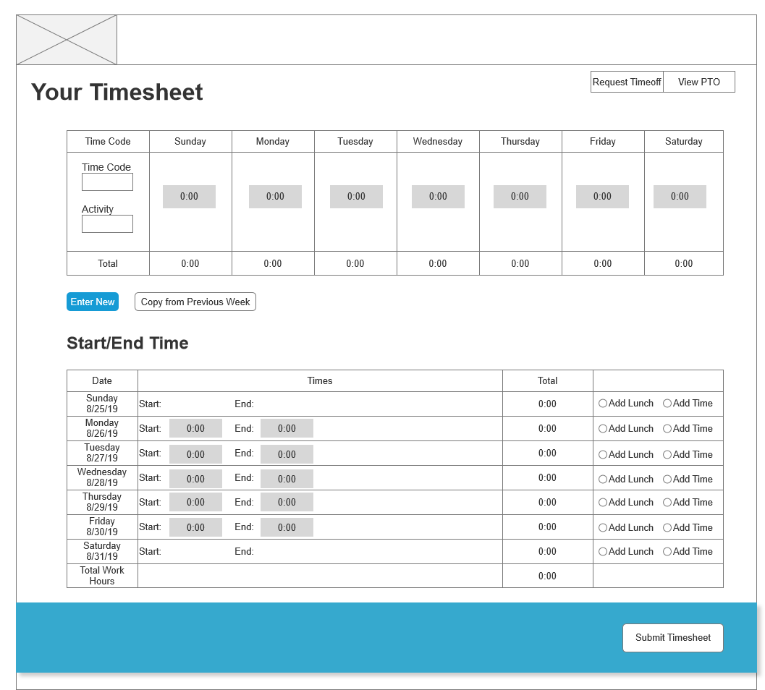
Prototype
https://iydqqe.axshare.com

Slide 12
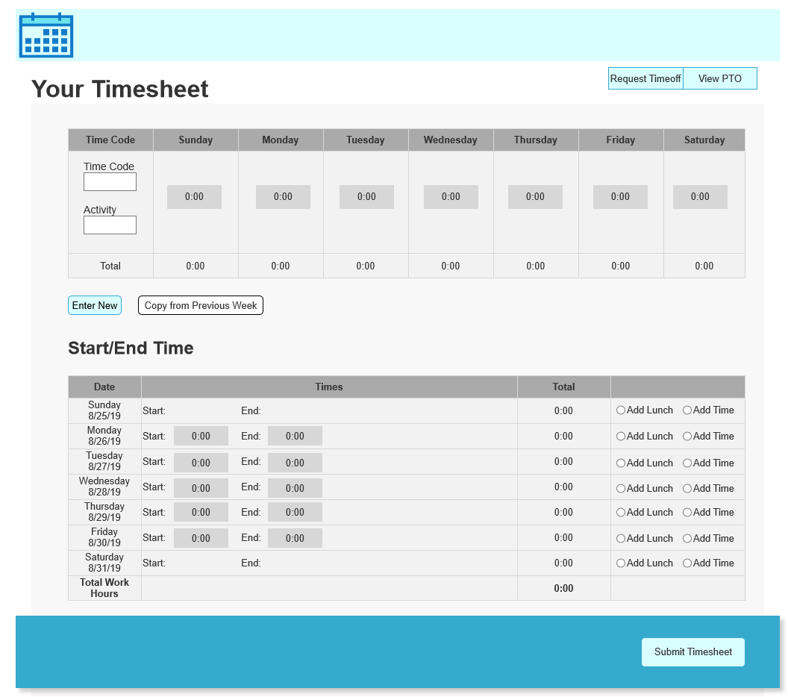
Final Design
https://3fmrp7.axshare.com/
Walk Through:
https://youtu.be/HZOyXk-ILxI

Slide 13
Obstacles and Victories
One of my biggest obstacles was defining a complete user story. I had only described my users during their work life, but the person as a whole is what makes a complete user story. I know now how to write better and complete user stories.
Another obstacle I faced during this was capturing the complete set of functionality needed in my wireframe. When I first created my wireframe I realized I had missed a few key elements in the design. It wasn’t until I went back through the prototype did I realize exactly what I was missing in my designs.
My biggest victory was my creation of the wireframe. For my wireframe I had put in a lot of effort to make it as complete as possible. This allowed me to articulate my ideas the best way possible. It also created an excellent foundation to build my prototype off of and my final design when I added in the aesthetics.

